Slide 1


Implementation of basic ciphers on FPGA using VHDL
Subject : BPC-DE1
Year : 2023/24
Team members:
Jindřich Zobač Erik Straka Vít Vašenka

Slide 2

Introduction
Goal: create a basic cipher decoder on FPGA
User should type in string of characters using HMI (in this case mobile phone-like keypad)
User can choose among various cipher algorithms (Vernam, Caesar, Atbash)
User can define cipher keys when applicable (Vernam, Caesar)
Input string or coded/decoded string can be selected to be displayed on 7segment screen
Code has to be done in VHDL language and imported to Nexys A7– 50T FPGA dev. board
We divided the project into subtasks (HMI, Cipher, Display) among team members:
Jindra Zobac: HMI, top-level + testbench
Vít Vašenka: all cipher algorithms
Erik Straka: Display interface, GitHub repository

Slide 3
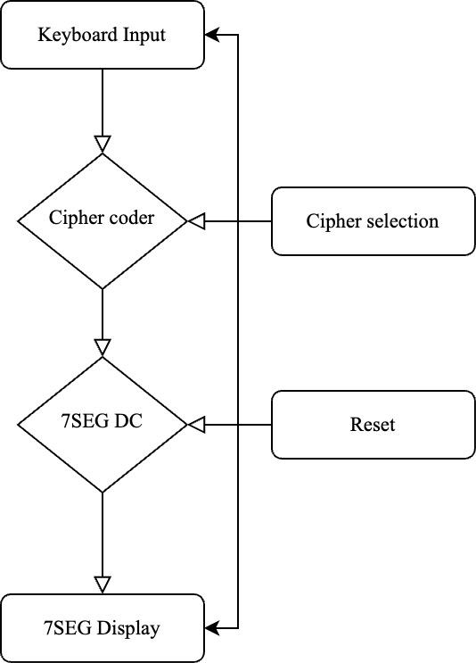
State machine diagram
Shows how is code executed
Note that on FPGA everything happens in parallel
Bypass switch

Slide 4
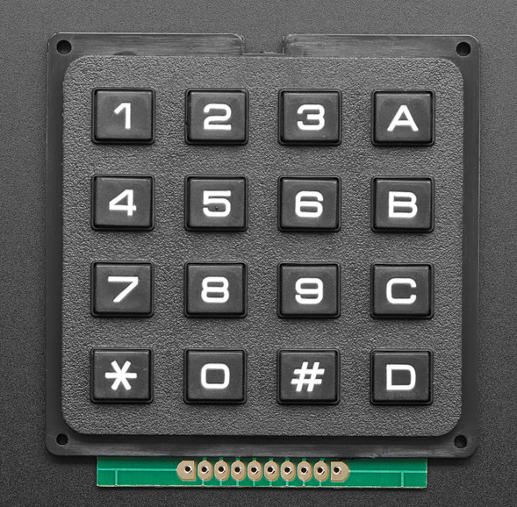
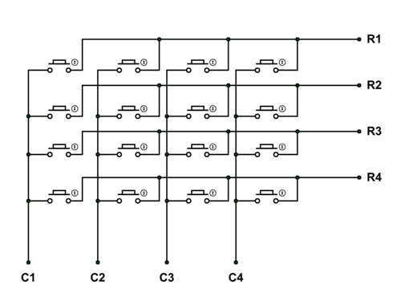
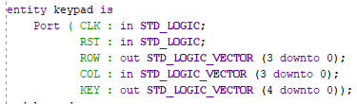
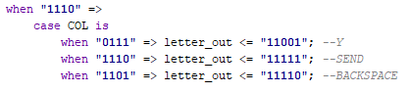
Keyboard Input for HMI
4x4 matrix keypad
Module structure:
FSM – cycles trough rows, one row is set LOW at a time, controlled by CLK signal
MUX – column readout: if LOW is detected in any column, respective key can be assigned utilizing the information about rows
Continuous output is further processed in „Interpreter“ module
5 bit character codes (00001 = A, 11010 = Z)
Special function buttons (SEND = 11111, BACKSPACE = 11110) – same principle
A, B
C,D
E, F
G, H
I, J
K, L
M, N
O, P
Q, R
S, T
U, V
W, X
Y, Z
N/A
BCKSPC
SEND

Slide 5
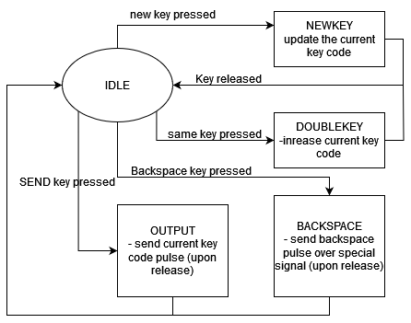
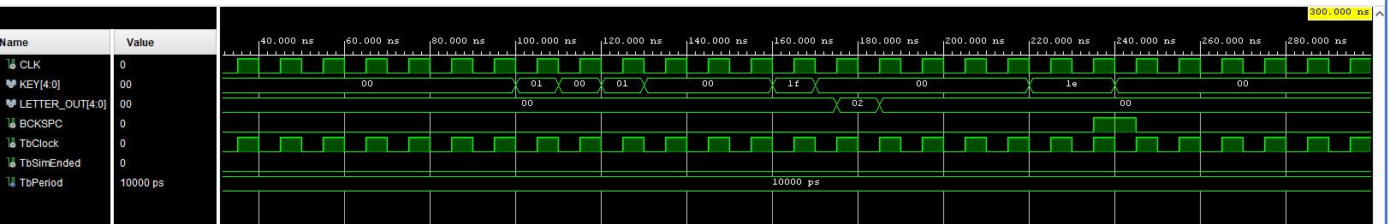
Keyboard Input Interpreter
Purpose: generate a short pulse containing a letter code upon every hit of "SEND" key.
The resulting letter code is based on last 2 pressed keys.
If double press is detected, the input letter code is incremented (= next letter)
also triggers BACKSPACE pulse upon press of BACKSPACE key
to move back in the shift register - input correction
Principle: FSM

Slide 6
Cipher Algorithms
The second subtask is about the implementation of various cipher algorithms
Ciphers that we implemented:
1. Vernam cipher
2. Caesar cipher
3. Atbash cipher

Slide 7
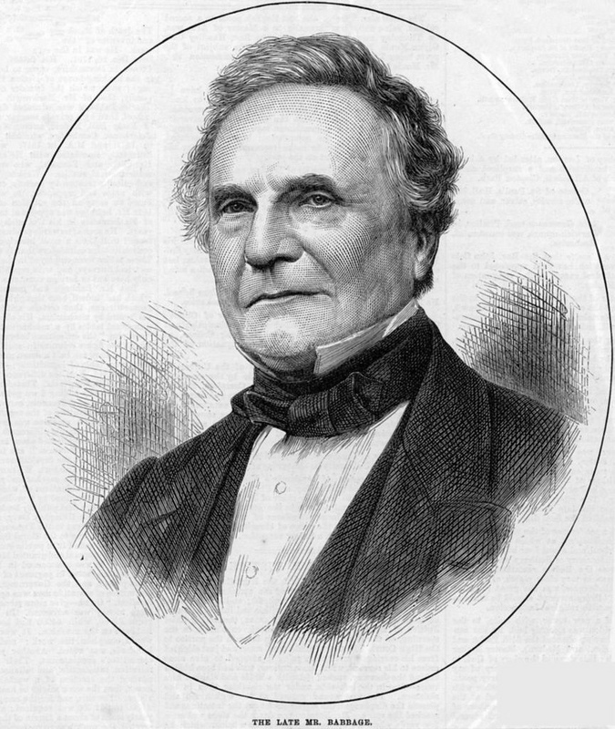
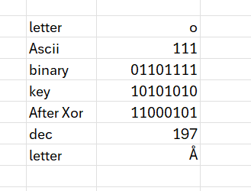
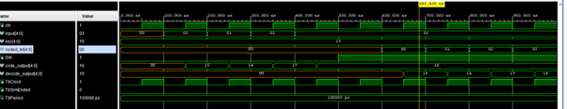
Vernam cipher
1917 Gilbert Vernam
First cipher we tried to implement on FPGA was Vernam cipher
It is a simple cipher that codes and decodes text base on XOR function
„disposable“ cipher – key to be used one time only
For coding/decoding you need key that stays the same for both processes

Slide 8
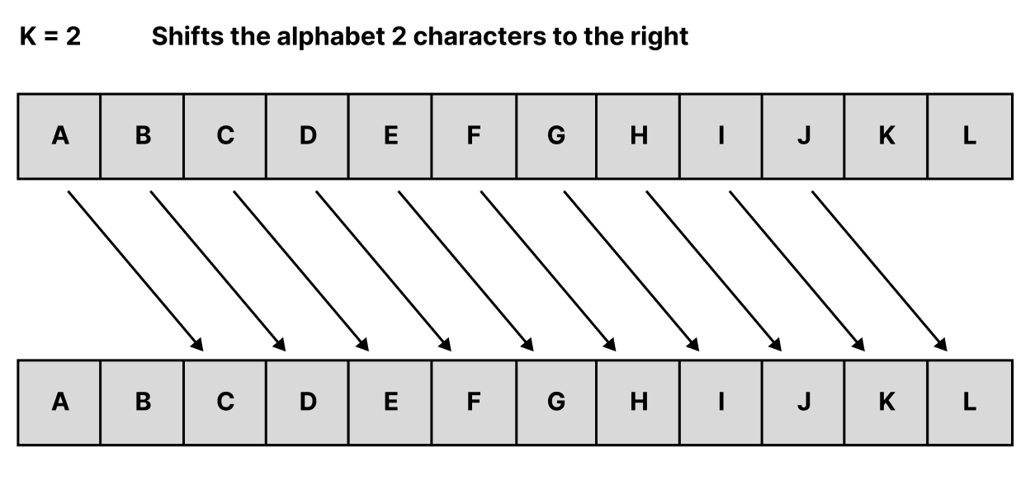
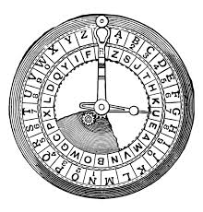
Caesar cipher
Caesar cipher works on shifting words in alphabeth
Julius Caesar around 58 BC
The implementation of this cipher was very similar to the Vernam cipher, the main difference is in using plus and minus operations instead of XOR function
For coding/decoding you also need key (the number to shift the alphabet by)

Slide 9
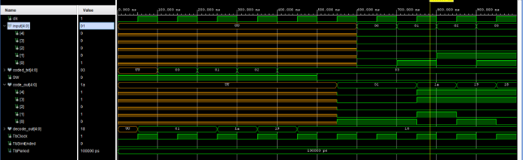
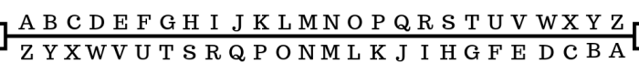
Atbash cipher
This cipher has only one specific key (hardcoded, not user selectable)
It works by reversing the letters in the alphabet (so A becomes Z etc.)
For coding and decoding I used case-when statements
This cipher was the easiest to create, so we decided to test this one first on FPGA

Slide 10
Display of cipher output on display
The final subtask is focused on decoding the output generated by the cipher algorithms and displaying them on seven-segment displays
7 segment display is driven using method called Multiplexing
This method turns on and off each display one by one with higher refresh rate than human eye, typically hundreds or thousands of Hz
We are using 4 digits of 7 segment display

Slide 11
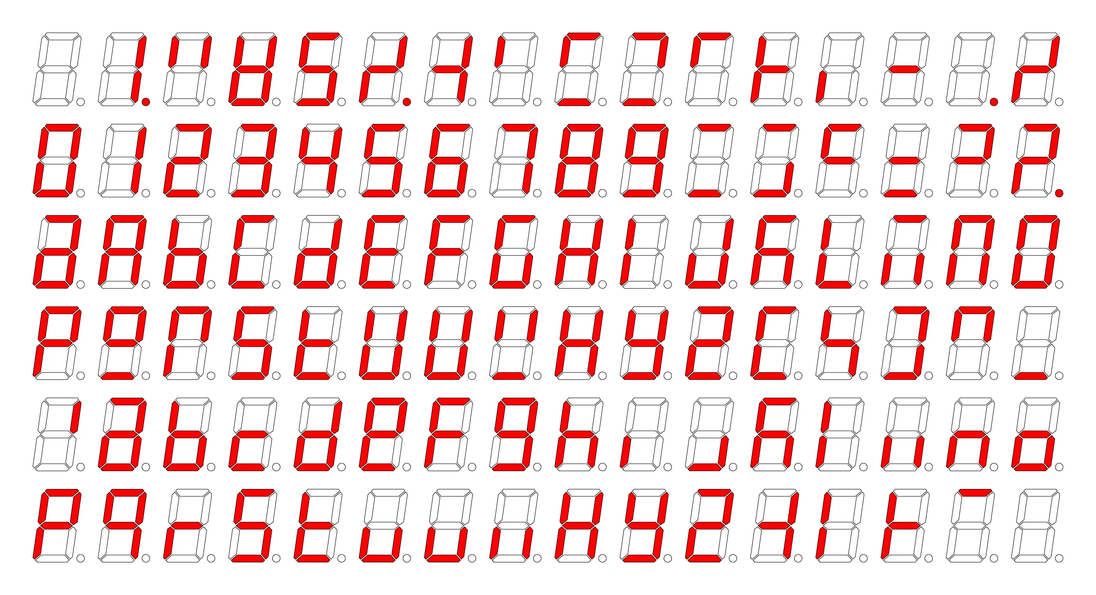
Display of cipher output on display
Character | DEC | BIN | 7SEG [gfedcba]
A | 1 | 00001 | 1011111
B | 2 | 00010 | 1111100
C | 3 | 00011 | 1011000
D | 4 | 00100 | 1011110
E | 5 | 00101 | 1111001
F | 6 | 00110 | 1110001
G | 7 | 00111 | 0111110
H | 8 | 01000 | 1110100
I | 9 | 01001 | 0010001
J | 10 | 01010 | 0001101
K | 11 | 01011 | 1110101
L | 12 | 01100 | 0111000
M | 13 | 01101 | 1010101
N | 14 | 01110 | 1010100
O | 15 | 01111 | 1011100
P | 16 | 10000 | 1110011
Q | 17 | 10001 | 1100111
R | 18 | 10010 | 1010000
S | 19 | 10011 | 0101101
T | 20 | 10100 | 1111000
U | 21 | 10101 | 0011100
V | 22 | 10110 | 0101010
W | 23 | 10111 | 1101010
X | 24 | 11000 | 0010100
Y | 25 | 11001 | 1101110
Z | 26 | 11010 | 0011011
Decoder for 7 segment display is basically demultiplexer
For our case we designed 5 to 7 demultiplexer
We used 5 bits - that gives us range for 32 characters
In alphabeth, we want to display, there is 25 chars.
We made our own table for each character
Shift registers shall be used to display multiple characters
Inspiration

Slide 12
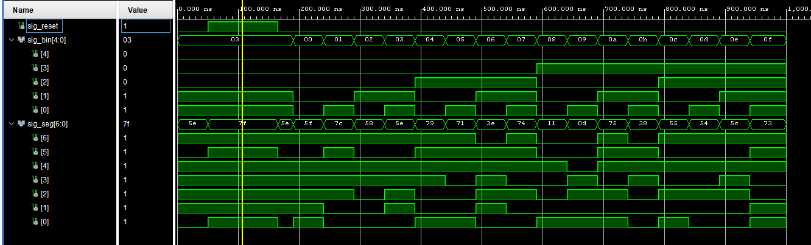
Display testbench

Slide 13
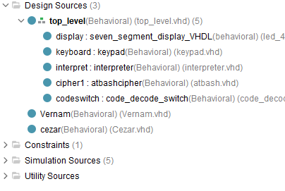
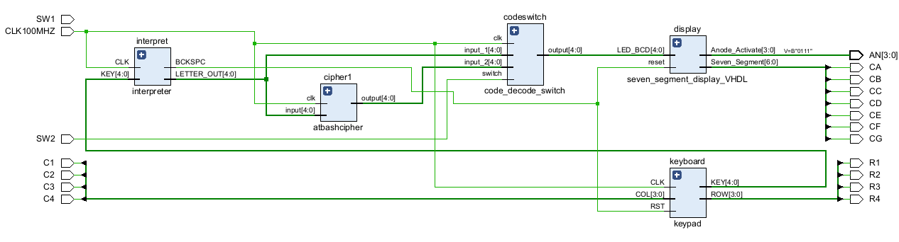
Top level
The modules are interconnected in a way to reach the desired function
Project has more potential than currently utilized in top_level (see roadmap)
The basic function of the project was successfully tested in testbench (see testbench results)

Slide 14
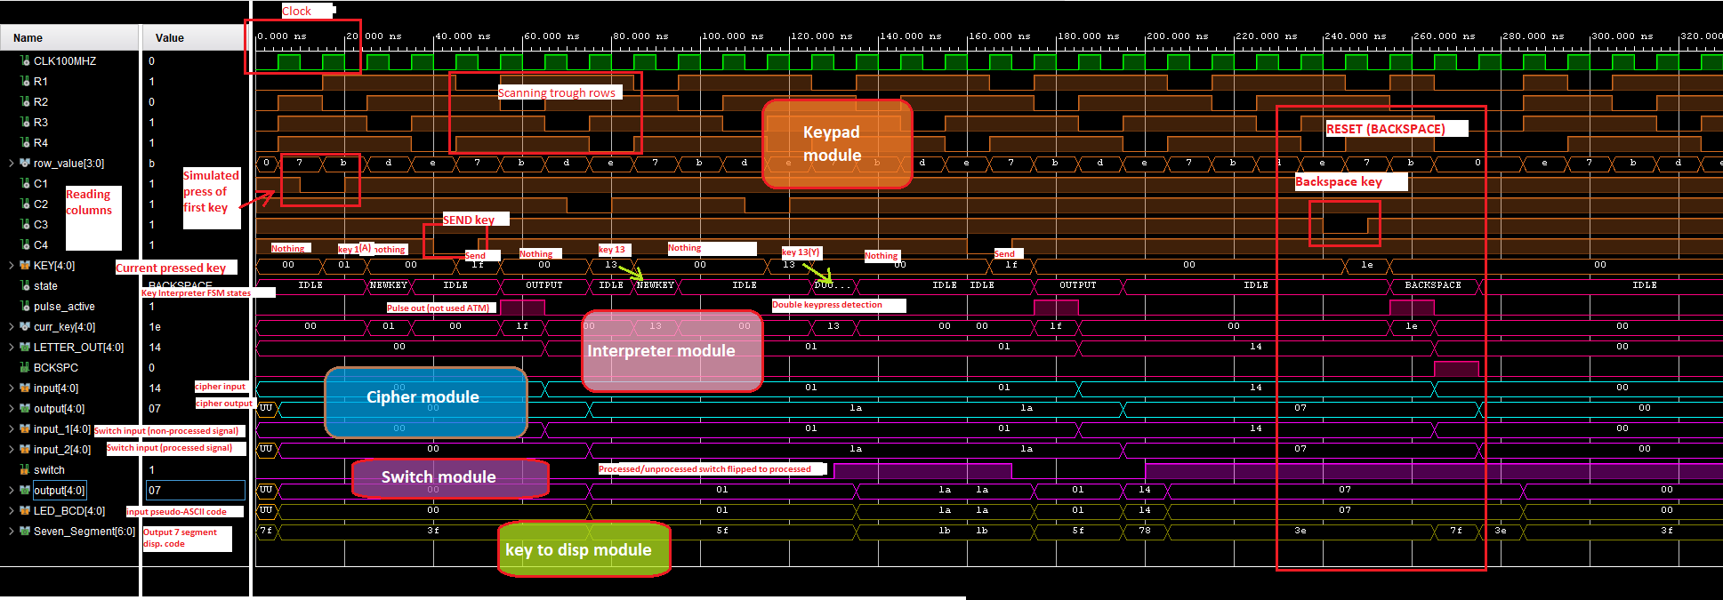

Slide 15
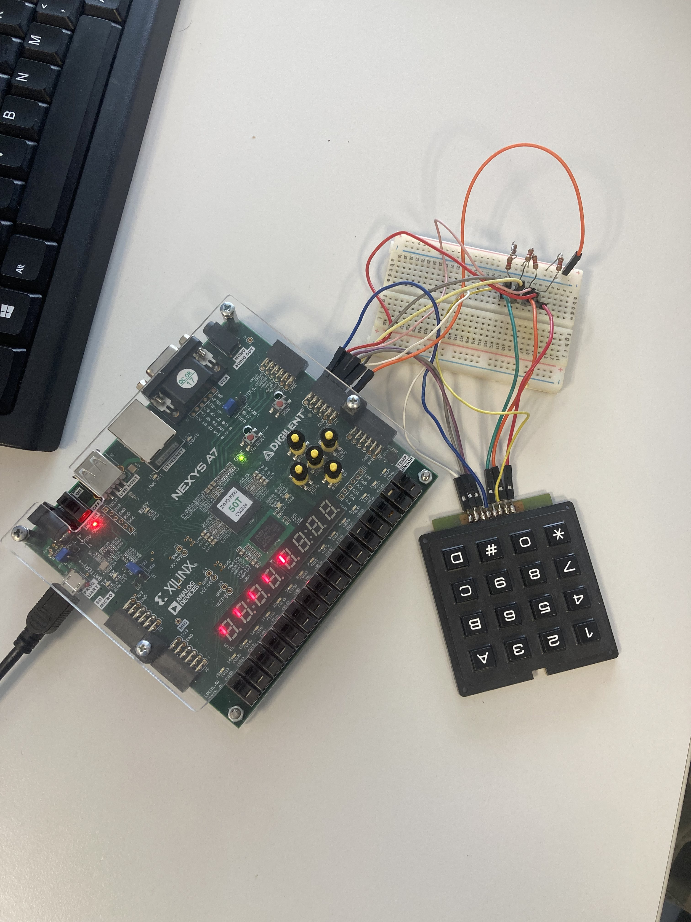

Roadmap
Unfortunately we weren‘t able to complete all set goals
 | Code written | testbench OK | Utilized in Top Level | Hardware implementation
Keypad input | YES | YES | YES | NO
Vernam Cipher | YES | YES | NO
Atbash Cipher | YES | YES | YES
Caesar Cipher | YES | YES | NO
Display output | YES | YES | YES
Top-level integration | YES | YES | N/A
Constraints | YES | N/A | N/A
Multi-character ciphers | NO | NO | NO
Debouncers | NO | NO | NO | NO
TODO:
Debouncers
Cipher switcher – Ave Caesar
Shift register
Hardware implementation

Slide 16
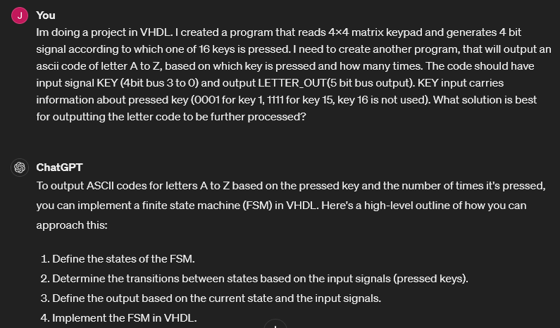
Sources
ChatGPT usage: used only for consultation purposes
Former VHDL projects: https://github.com/tomas-fryza/vhdl-course
Online VHDL testbench generator https://vhdl.lapinoo.net/testbench/
Nexys A50T reference manual
Digital electronics 1 VHDL Guidelines, Tomas Fryza
Example prompt

